Slide 1
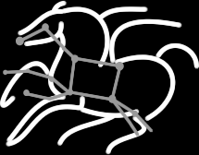
Scientific Workflows with Pegasus and DAGMan
Karan Vahi
Science Automation Technologies Group
USC Information Sciences Institute

Slide 2
Before we begin
The tutorial involves hands on exercises.
https://pegasus.isi.edu/tutorial/chtc15/index.php
If you have a CHTC account, then you can logon to submit-5.chtc.wisc.edu to do the tutorial.
ssh <username>@submit-5.chtc.wisc.edu
Replace <username> with your username e.g. nu_vahi

Slide 3
Agenda
Introduction to Workflows and Pegasus
Hands-on Pegasus Tutorial Demonstration
Compose, setup and run a simple workflow
Monitor , debug and generate statistics of a workflow.
Run the same workflow with clustering turned on
Compose and submit a workflow with a MPI job.
Advanced Topics

Slide 4
Scientific Workflows
Orchestrate complex, multi-stage scientific computations
Often expressed as directed acyclic graphs (DAGs)
Capture analysis pipelines for sharing and reuse
Can execute in parallel on distributed resources
Setup
Split
Filter & Convert
Map
Merge
Analyze
Epigenomics Workflow
Notes:
Expressed in high-level workflow languages

Slide 5
Scientific Workflow Challenges
Portability
How can you run a pipeline on Amazon EC2 one day, and a PBS cluster the next?
Data Management
How do you ship in the small/large amounts data required by your pipeline?
Different protocols for different sites: Can I use SRM? How about GridFTP? HTTP and Squid proxies?
Can I use Cloud based storage like S3 on EC2?
Debug and Monitor Computations.
Users need automated tools to go through the log files
Need to correlate data across lots of log files
Need to know what host a job ran on and how it was invoked
Restructure Pipelines for Improved Performance
Short running tasks?
Data placement?

Slide 6
Pegasus Workflow Management System (est. 2001)
A collaboration between USC and the Condor Team at UW Madison (includes DAGMan)
Maps a resource-independent “abstract” workflow onto resources and executes the “executable” workflow
Used by a number of applications in a variety of domains
Provides reliability—can retry computations from the point of failure
Provides scalability—can handle large data and many computations (kbytes-TB of data, 1-10⁶ tasks)
Infers data transfers, restructures workflows for performance
Automatically captures provenance information
Can run on resources distributed among institutions, laptop, campus cluster, Grid, Cloud

Slide 7
Pegasus WMS Environment

Slide 8
Pegasus Workflow Management System
Abstract Workflows - Pegasus input workflow description
Workflow “high-level language”
Only identifies the computation, devoid of resource descriptions, devoid of data locations
File Aware
Pegasus is a workflow “compiler” (plan/map)
Target is DAGMan DAGs and Condor submit files
Transforms the workflow for performance and reliability
Automatically locates physical locations for both workflow components and data
Collects runtime provenance

Slide 9
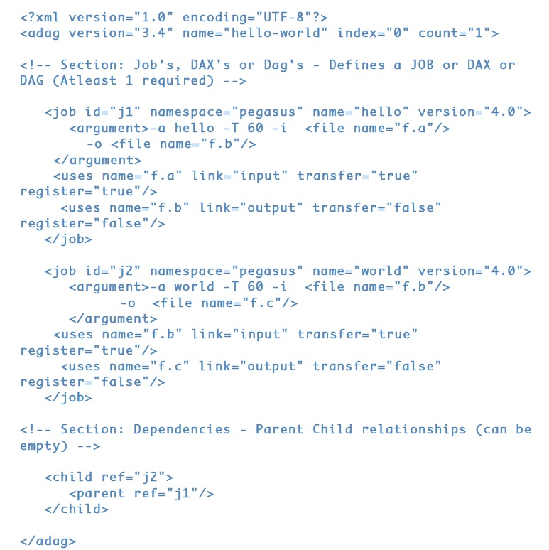
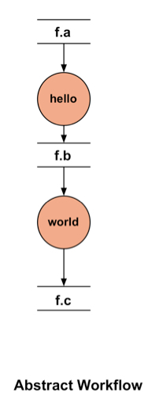
DAX – XML format to describe Abstract Workflows

Slide 10
Abstract to Executable Workflow Mapping - Discovery
Data
Where do the input datasets reside?
Executables
Where are the executables installed ?
Do binaries exist somewhere that can be staged to remote grid sites?
Site Layout
What does a execution site look like?
Abstract Workflow
Replica Catalog
Pegasus
Workflow
Compiler
Transformation
Catalog
Site Catalog
Executable Workflow

Slide 11
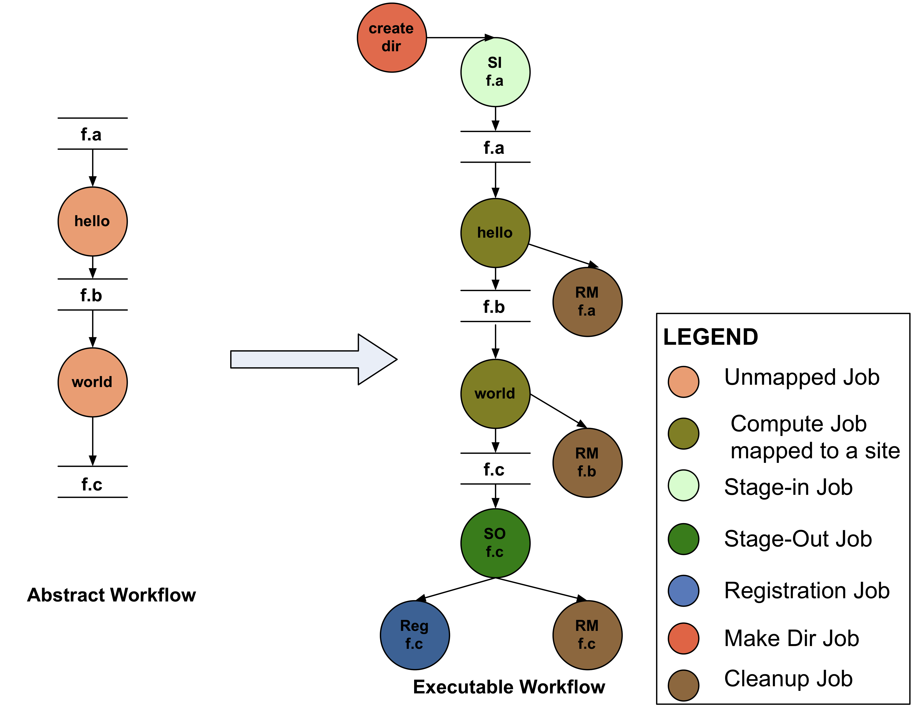
Abstract to Executable Workflow Mapping
Abstraction provides
Ease of Use (do not need to worry about low-level execution details)
Portability (can use the same workflow description to run on a number of resources and/or across them)
Gives opportunities for optimization and fault tolerance
automatically restructure the workflow
automatically provide fault recovery (retry, choose different resource)

Slide 12
Simple Steps to Run Pegasus
Specify your computation in terms of DAX
Write a simple DAX generator
Python, Java , Perl based API provided with Pegasus
Set up your catalogs
Replica catalog, transformation catalog and site catalog.
Plan and Submit your workflow
Use pegasus-plan to generate your executable workflow that is mapped onto the target resources and submits it for execution
Monitor and Analyze your workflow
Use pegasus-status | pegasus-analyzer to monitor the execution of your workflow
Workflow Statistics
Run pegasus-statistics to generate statistics about your workflow run.

Slide 13
Different Directories used by Pegasus
Submit Directory
The directory where pegasus-plan generates the executable workflow i.e HTCondor DAGMan and job submit files.
Specified by --dir option to pegasus-plan
Input Directory
Mostly input file locations are catalogued in the Replica Catalog.
However, if inputs are on the submit host ( i.e. where Pegasus is installed), then you can pass –input-dir option to pegasus-plan
Scratch Directory
Workflow specific directory created by the create-dir job on the shared filesystem of HPCC. This is where all the jobs run.
The base directory specified in the site catalog entry for HPCC in sites.xml file.
Output Directory
The output directory where the outputs of the workflow appear.
Specified in the output site ( “local” ) entry in the sites.xml file.
Can also be optionally specified by –output-dir option to pegasus-plan

Slide 14
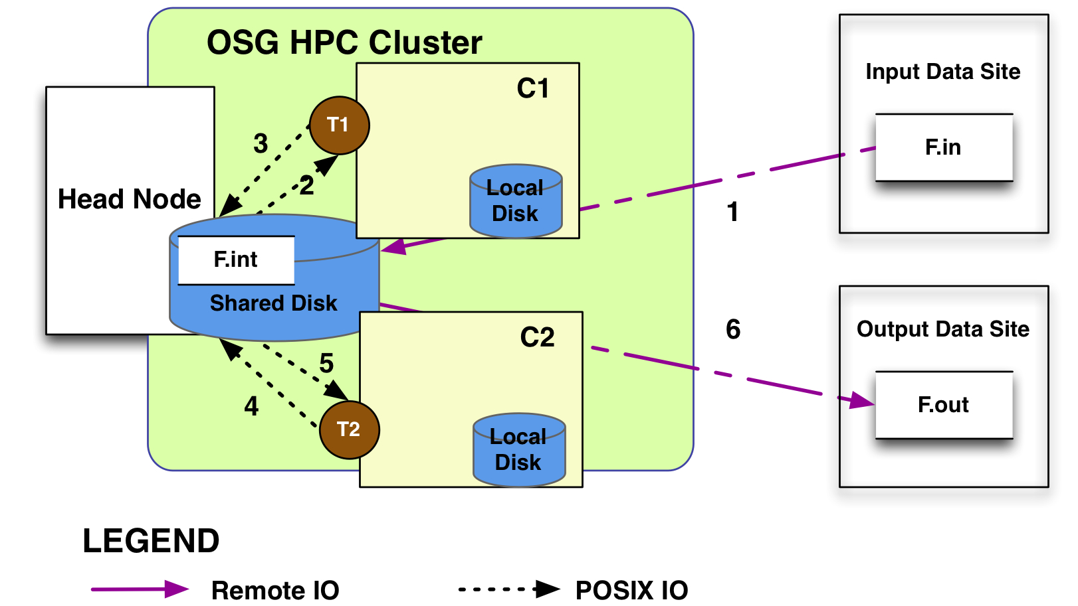
How does Pegasus view a compute resource as?
For Pegasus a compute resource or a site is associated with the following
An entry point or a scheduler contact to submit jobs to e.g PBS/LSF/Condor
File servers to stage data to the cluster
Different types of directories on the site
Shared-scratch - shared across all the worker nodes in the site
Local – a directory/filesystem local to the node where a job executes
Site wide information like environment variables to be set when a job is run.

Slide 15
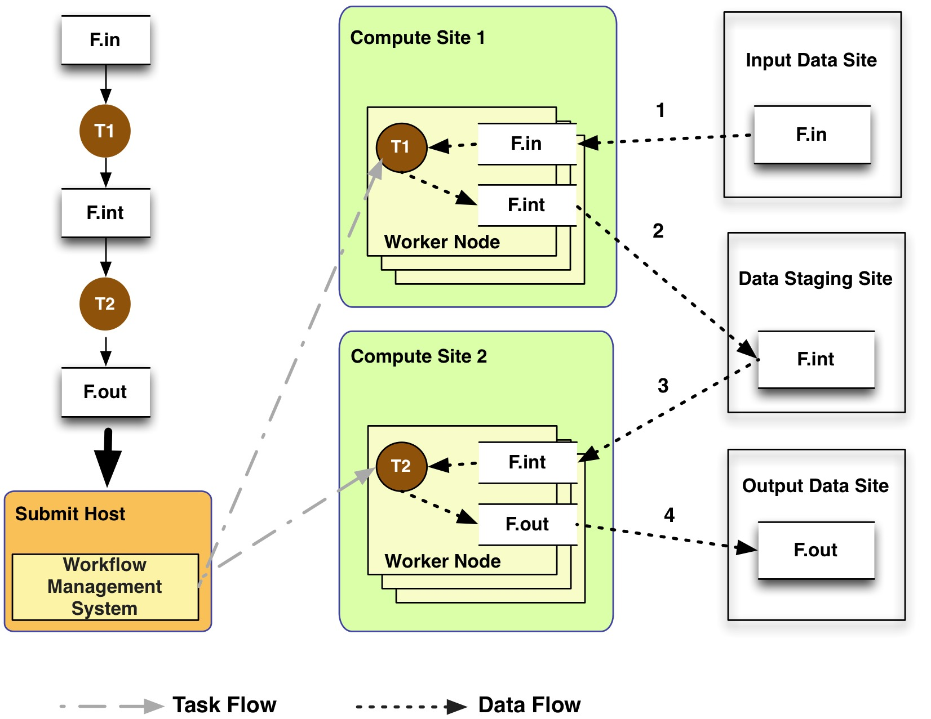
General Workflow Execution Model
Most of the tasks in scientific workflow applications require POSIX file semantics
Each task in the workflow opens one or more input files
Read or write a portion of it and then close the file.
Data Staging Site can be the shared filesystem on the compute cluster!
Input Data Site, Compute Site and Output Data Sites can be co-located
Example: Input data is already present on the compute site.
Notes:
Remember to describe each type of site

Slide 16
Supported Data Staging Approaches - I
Shared Filesystem setup (typical of XSEDE and HPC sites)
USC HPCC
Cluster
Worker nodes and the head node have a shared filesystem, usually a parallel filesystem with great I/O characteristics
Can leverage symlinking against existing datasets
Staging site is the shared-fs.
Compute Site
WN
Submit
Host
Shared
FS
WN
hpc-pegasus
Non-shared filesystem setup with staging site (typical of OSG and EC 2)
Worker nodes don’t share a filesystem.
Data is pulled from / pushed to the existing storage element.
A separate staging site such as S3.
Compute Site
Submit
Host
WN
Staging
Site
WN
Amazon
EC2 with S3
Jobs
Data
Notes:
Kent changed 080501 – removed periods

Slide 17
Supported Data Staging Approaches - II
Submit
Host
Condor IO ( Typical of large Condor Pools like CHTC)
Worker nodes don’t share a filesystem
Symlink against datasets available locally
Data is pulled from / pushed to the submit host via Condor file transfers
Staging site is the submit host.
Local FS
Jobs
Data
Compute Site
WN
WN
Supported Transfer Protocols
HTTP
SCP
GridFTP
IRODS
S3
Condor File IO
File Copy
Using Pegasus allows you to move from one deployment to another without changing the workflow description!

Slide 18
Notes:
On of the things we have done to handle big datasets is created this notion of a staging site or intermediate data site. Since most compute resources may or may not have large data storage capability. This allows us to use a mixture of resources when executing workflows and using the various high performance data protocols that may be available to fetch the data to the compute node for execution as and when its needed.

Slide 19
Workflow Restructuring to improve application performance
Cluster small running jobs together to achieve better performance
Why?
Each job has scheduling overhead – need to make this overhead worthwhile
Ideally users should run a job on the grid that takes at least 10/30/60/? minutes to execute
Clustered tasks can reuse common input data – less data transfers
Horizontal clustering
Label-based clustering

Slide 20
Pegasus-MPI-Cluster
A master/worker task scheduler for running fine-grained workflows on batch systems
Runs as an MPI job
Uses MPI to implement master/worker protocol
Works on most HPC systems
Requires: MPI, a shared file system, and fork()
Allows sub-graphs of a Pegasus workflow to be submitted as monolithic jobs to remote resources
Master
(rank 0)
Worker
(rank 1-N)

Slide 21
PMC Features
Fault Tolerance
Retries at the task level (master resends task to another worker)
Retries at the workflow level (using a transaction log to record progress)
Resource-aware scheduling
Many HPC machines have low memory/core
PMC can allocate memory and cores to a task, and force other slots on the same node to be idle
I/O Forwarding
Small tasks == small I/O == poor performance
PMC reads data off of pipes from worker and forwards it using MPI messages to a central I/O process, which collects the data and writes it to disk
Writes are not interleaved, no locking required for synchronization

Slide 22
Workflow Reduction (Data Reuse)
Useful when you have done a part of computation and then realize the need to change the structure. Re-plan instead of submitting rescue DAG!
Notes:
Sometimes it is cheaper to access the data than to regenerate it
Keeping track of data as it is generated supports workflow-level checkpointing
Kent changed 080501 – added period

Slide 23
Data cleanup
Problem: Running out of disk space during workflow execution
Why does it occur
Workflows could bring in huge amounts of data
Data is generated during workflow execution
Users don’t worry about cleaning up after they are done
Solution
Do cleanup after workflows finish
Does not work as the scratch may get filled much before during execution
Interleave cleanup automatically during workflow execution.
Requires an analysis of the workflow to determine, when a file is no longer required
Cluster the cleanup jobs by level for large workflows
Real Life Example: Used by a UCLA genomics researcher to delete TB’s of data automatically for long running workflows!!
Notes:
Kent changed 080501

Slide 24
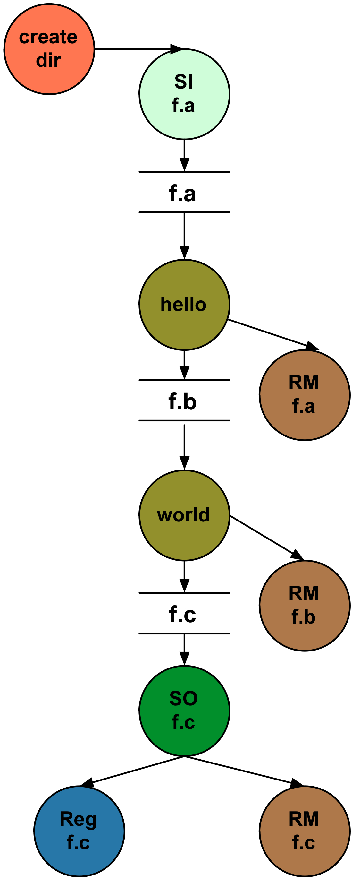
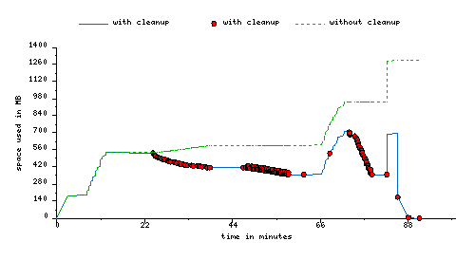
Data cleanup (cont)
Montage 1 degree workflow run with cleanup

Slide 25
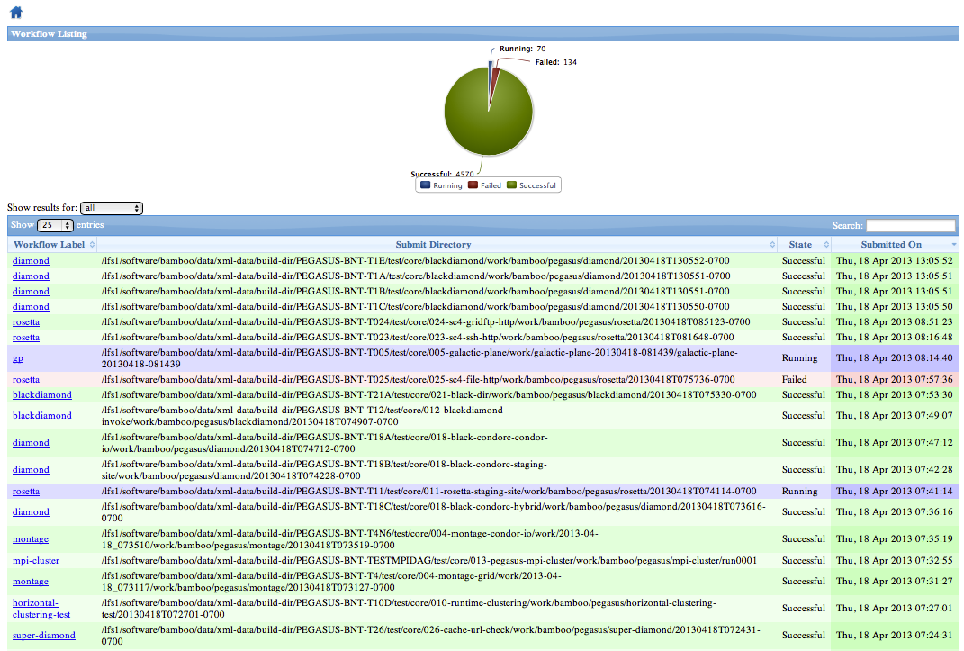
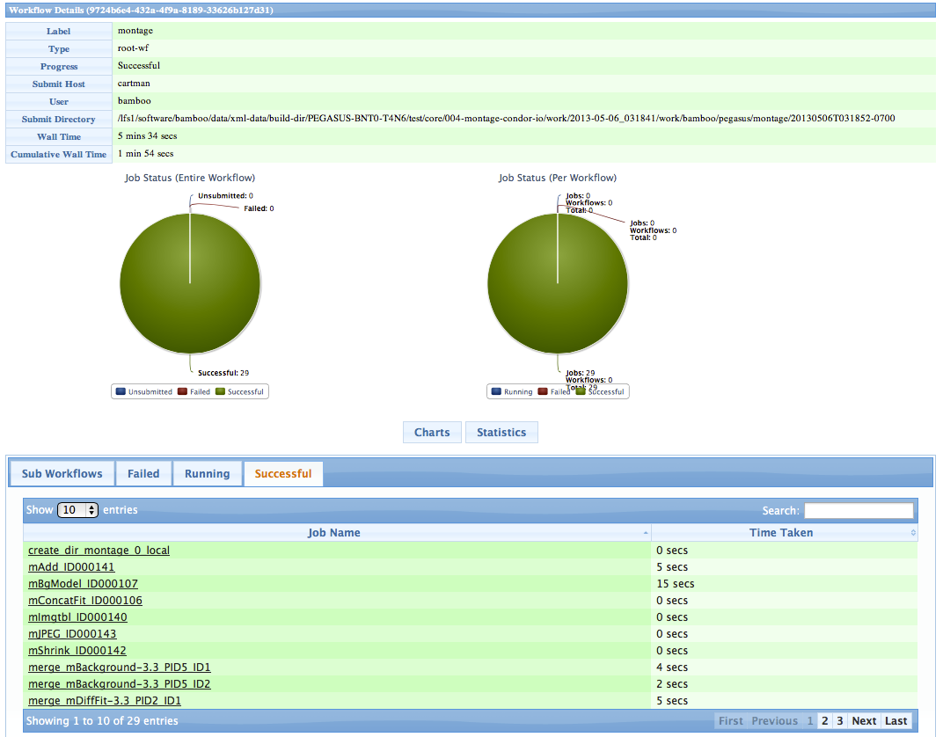
Pegasus Dashboard
Web-based workflow monitoring GUI
Data comes from monitoring database
Supports monitoring, troubleshooting, and reporting
Dashboard
Workflow Details
Job Details

Slide 26
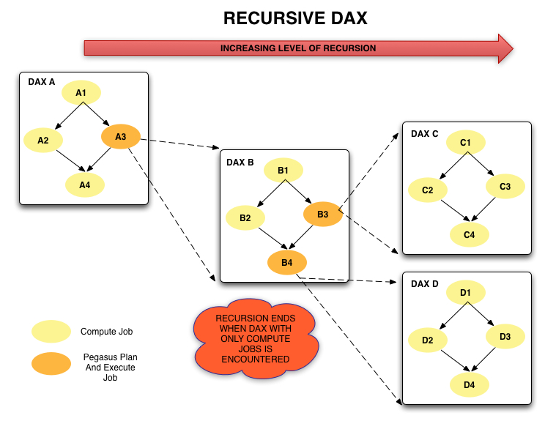
Hierarchical Workflows
Notes:
Kent changed 080430
Kent changed 080128-2 – added this slide
Talk about why

Slide 27
Example Hierarchical Workflow
<dax> element behaves like <job>
Arguments are for pegasus-plan (most are inherited)
Planner is invoked when DAX job is ready to run
<?xml version="1.0" encoding="UTF-8"?>
<adag version="3.4" name="multi-level">
<job id="ID0000001" namespace="example" name="sleep">
<argument>5</argument>
</job>
<dax id="ID0000002" file="sub.dax">
<argument>--output-site local</argument>
</dax>
<job id="ID0000003" namespace="example" name="sleep">
<argument>5</argument>
</job>
<child ref="ID0000002">
<parent ref="ID0000001"/>
</child>
<child ref="ID0000003">
<parent ref="ID0000002"/>
</child>
</adag>

Slide 28
What Does Pegasus provide an Application - I
Portability / Reuse
User created workflows can easily be mapped to and run in different environments without alteration.
Data Management
Pegasus handles replica selection, data transfers and output registrations in data catalogs. These tasks are added to a workflow as auxiliary jobs by the Pegasus planner.
Performance
The Pegasus mapper can reorder, group, and prioritize tasks in order to increase the overall workflow performance.
Notes:
Kent changed 080501 – removed period

Slide 29
What Does Pegasus provide an Application - II
Provenance
Provenance data is collected in a database, and the data can be summaries with tools such as pegasus-statistics, pegasus-plots, or directly with SQL queries.
Reliability and Debugging Tools
Jobs and data transfers are automatically retried in case of failures. Debugging tools such as pegasus-analyzer helps the user to debug the workflow in case of non-recoverable failures.
Scalability
Hierarchal workflows
Scale to hundreds of thousands of nodes in a workflow.
Notes:
Kent changed 080501 – removed period

Slide 30
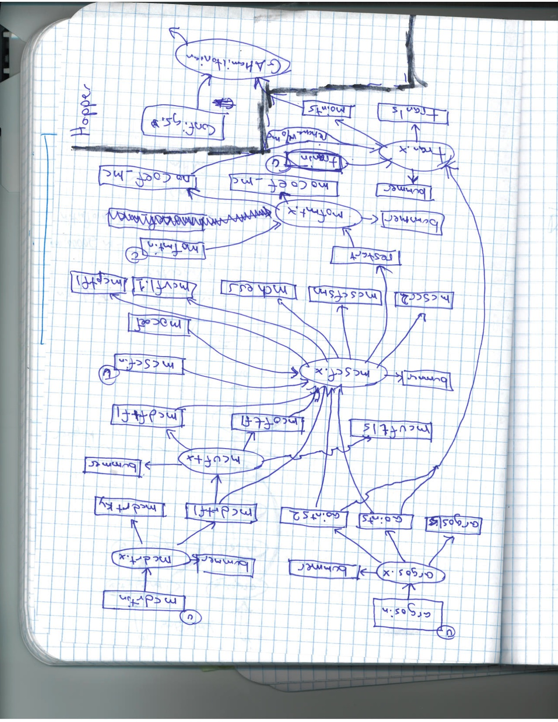
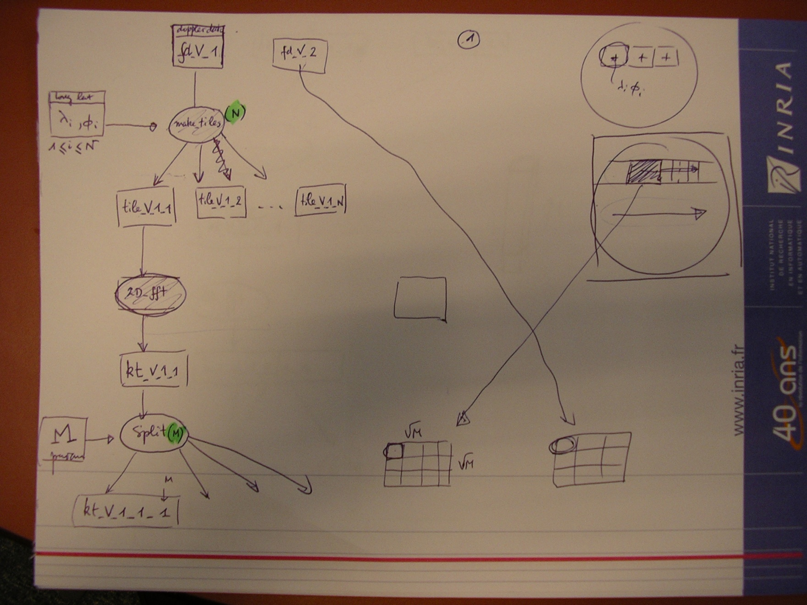
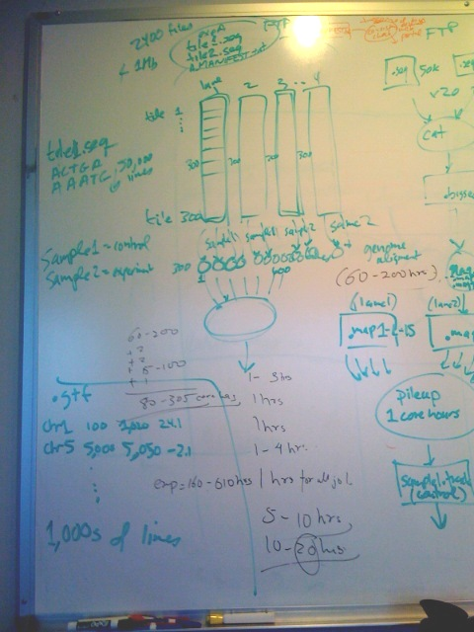
If you get stuck…
And you can draw….
We can help you!

Slide 31
More Information
Pegasus Website:
http://pegasus.isi.edu
Tutorial:
http://pegasus.isi.edu/wms/docs/latest/tutorial.php
Documentation:
http://pegasus.isi.edu/documentation
Email addresses:
Pegasus users list (public): pegasus-users@isi.edu
Pegasus support (private): pegasus-support@isi.edu

